Slide 1
4. Experiment with randomized QS (RQS) with both UD and ND as input data to arrive at the average complexity (count of operations performed) with both input datasets.

Slide 2
What is a Randomized Algorithm?
An algorithm that uses random numbers to decide what to do next anywhere in its logic is called a Randomized Algorithm. For example, in Randomized Quick Sort, we use a random number to pick the next pivot (or we randomly shuffle the array). And in Karger’s algorithm, we randomly pick an edge.

Slide 3
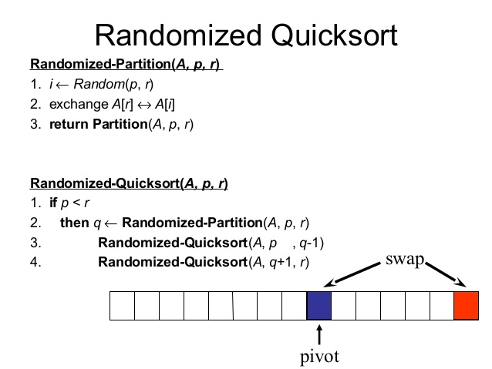
Randomized Quicksort Algorithm

Slide 4
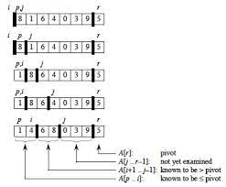
Working of Randomized Quicksort….

Slide 5
Time Complexity of RQ..
Randomized quicksort has expected time complexity as O(nLogn), but worst case time complexity remains same. In worst case the randomized function can pick the index of corner element every time.

Slide 6
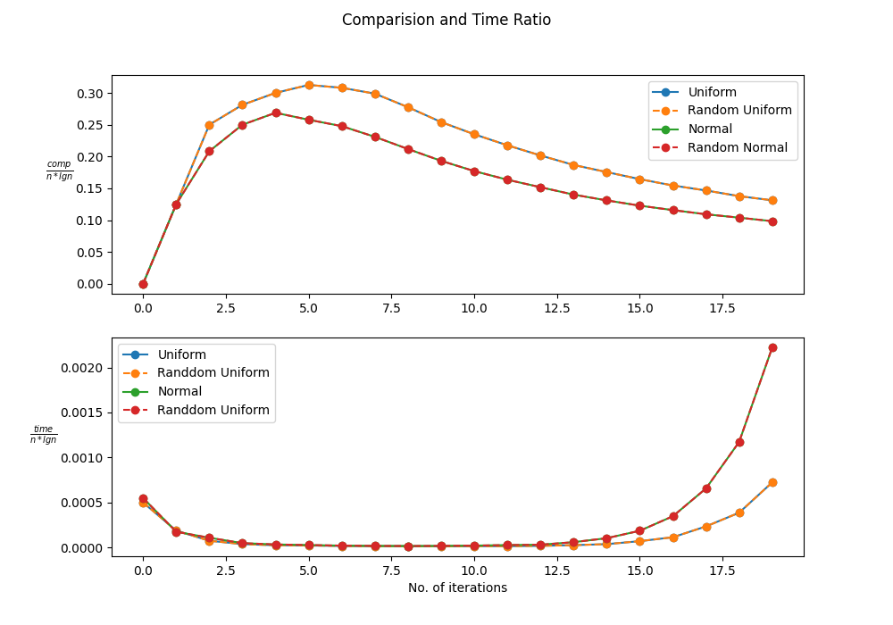
Observation

Slide 7
5. Now normalize both the datasets in the range from 0 to 1 and implement bucket sort (BS) algorithm and check for correctness.

Slide 8
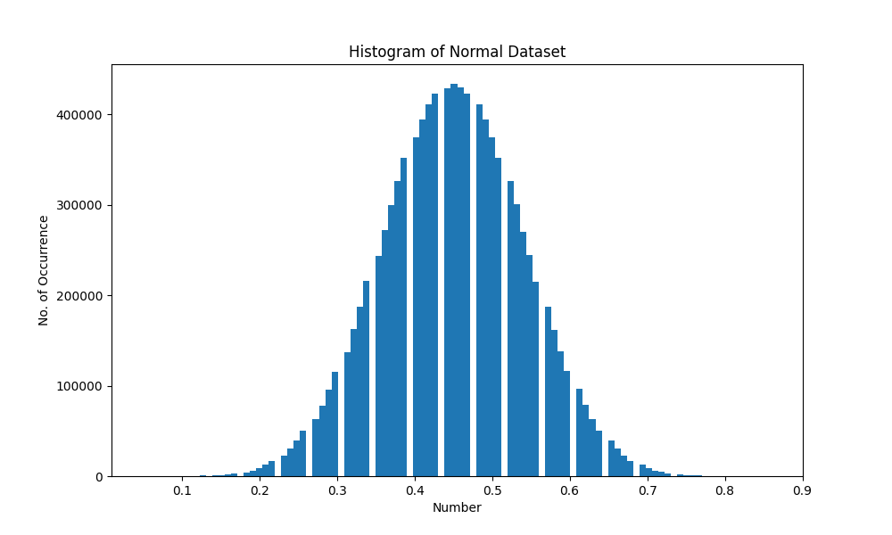
Histogram for Normal Dataset

Slide 9
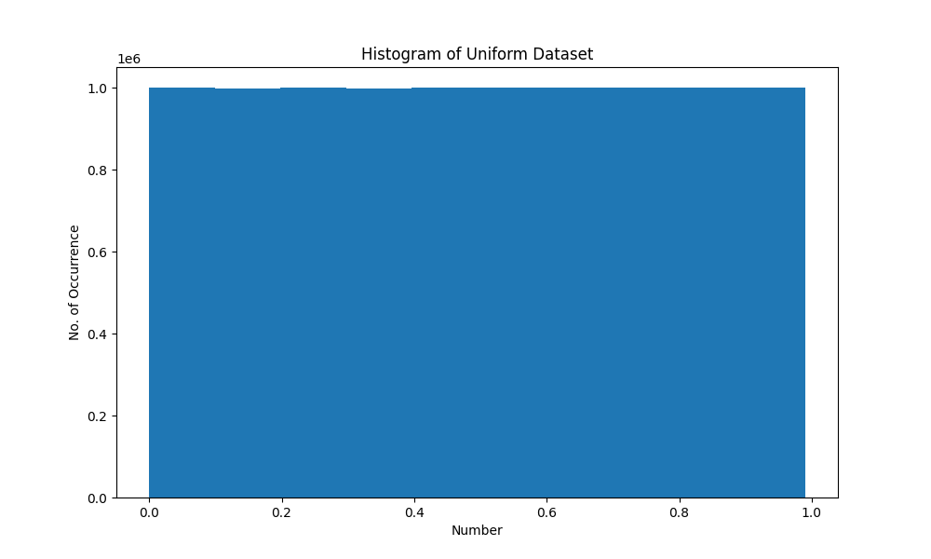
Histogram for Uniform Dataset

Slide 10
6. Experiment with BS to arrive at its average complexity for both UD and ND data sets and infer.

Slide 11
What is Bucket Sort
Bucket sort, or bin sort, is a sorting algorithm that works by distributing the elements of an array into a number of buckets. Each bucket is then sorted individually, either using a different sorting algorithm, or by recursively applying the bucket sorting algorithm. It is a distribution sort, a generalization of pigeonhole sort, and is a cousin of radix sort in the most-to-least significant digit flavor. Bucket sort can be implemented with comparisons and therefore can also be considered a comparison sort algorithm. The computational complexity depends on the algorithm used to sort each bucket, the number of buckets to use, and whether the input is uniformly distributed.

Slide 12
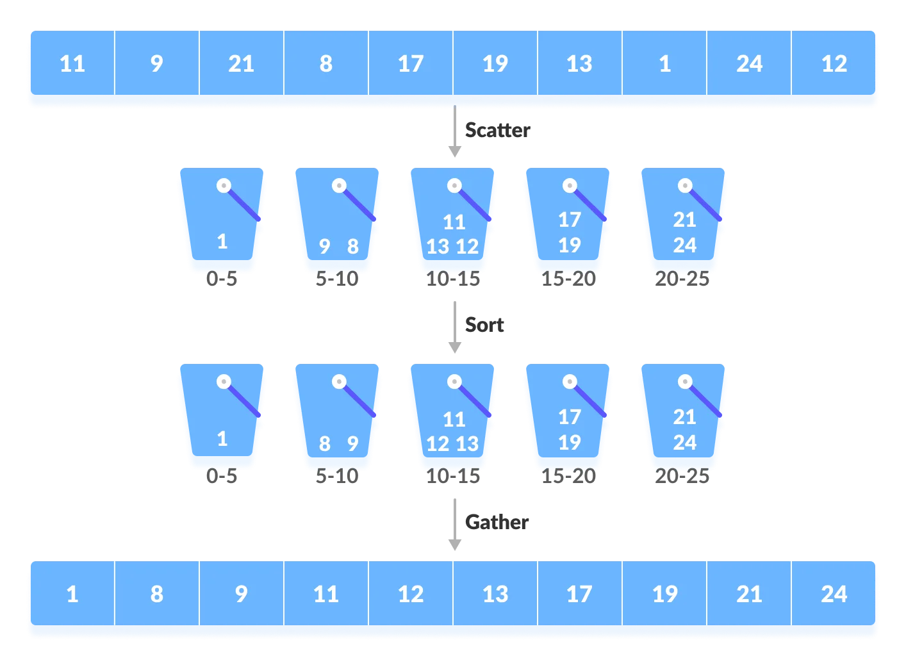
Bucket sort algorithm….

Slide 13
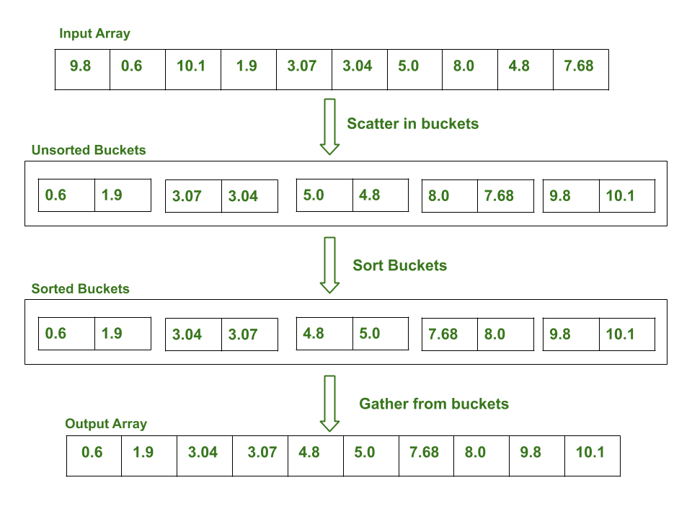
Bucket sort implementation on an array

Slide 14
The complexity of the Bucket Sort Technique
Time Complexity: O(n + k) for best case and average case and O(n^2) for the worst case.
Space Complexity: O(nk) for worst case

Slide 15
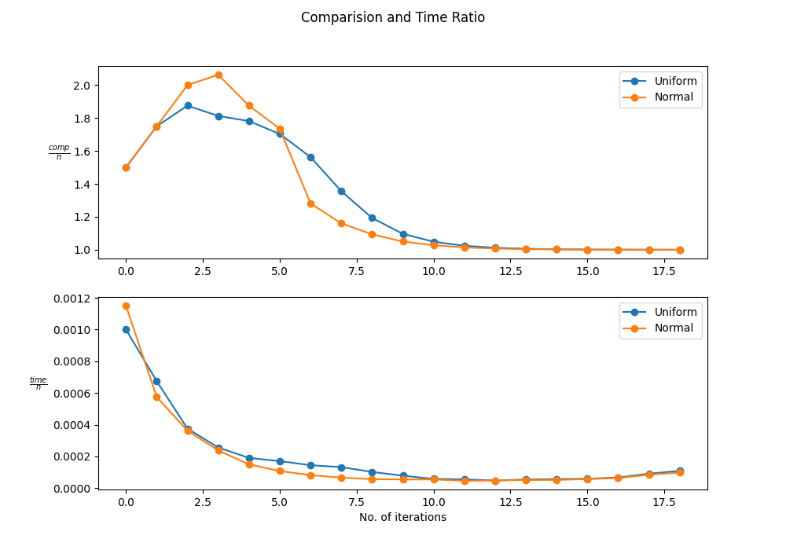
Observation

